Slide 1
Predicting Obesity
© Templateswise.com
Machine Learning Project by Dustin White

Slide 2
What problem am I going to solve?
To accurately predict whether individuals are obese based on a range of categorical variables.
Obesity is a significant public health concern linked to numerous diseases such as diabetes. Early detection can help to prevent these diseases and improve public health.
By identifying patterns and relationships within this data, ML models can predict obesity in individuals.

Slide 3
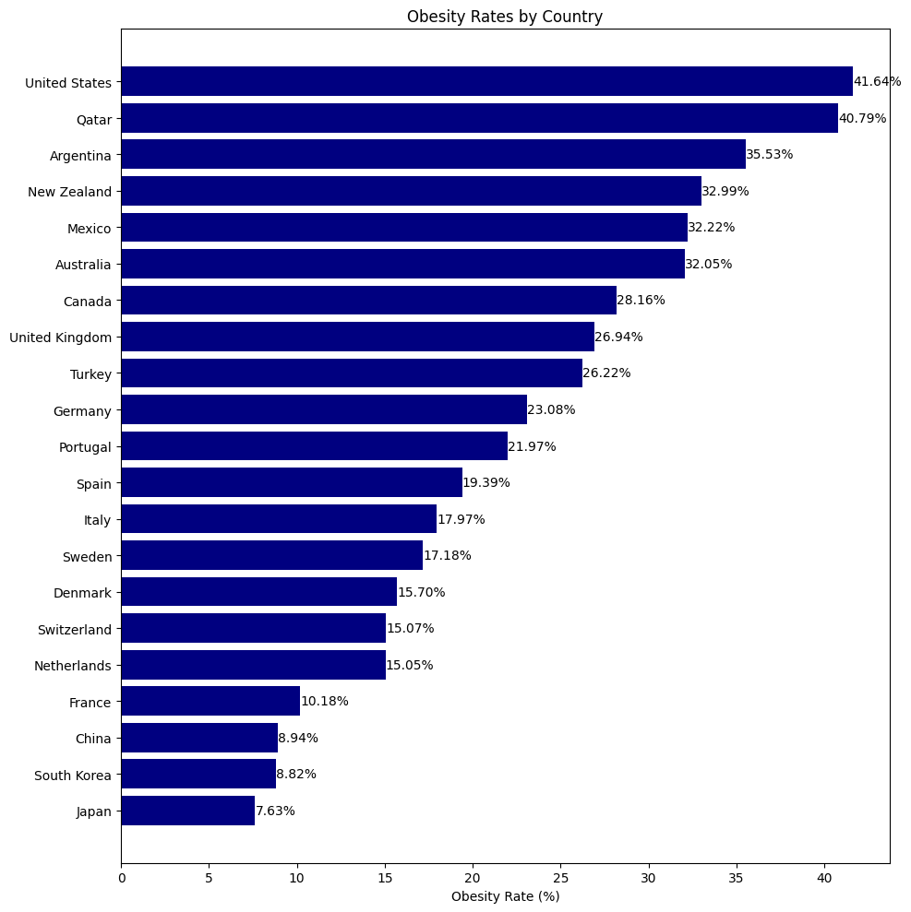

Slide 4
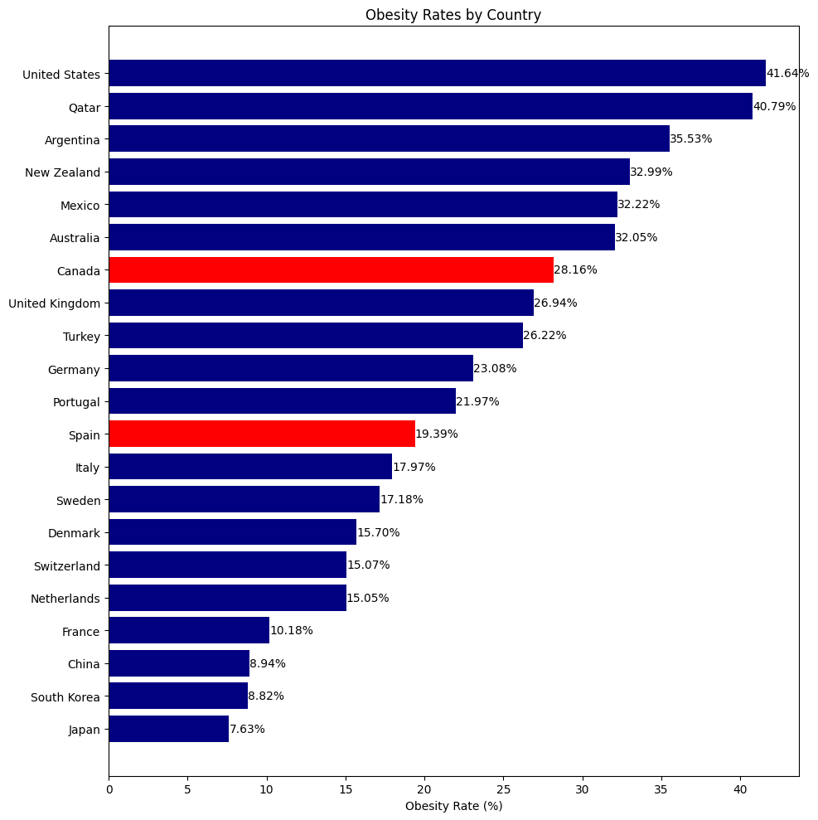

Slide 5
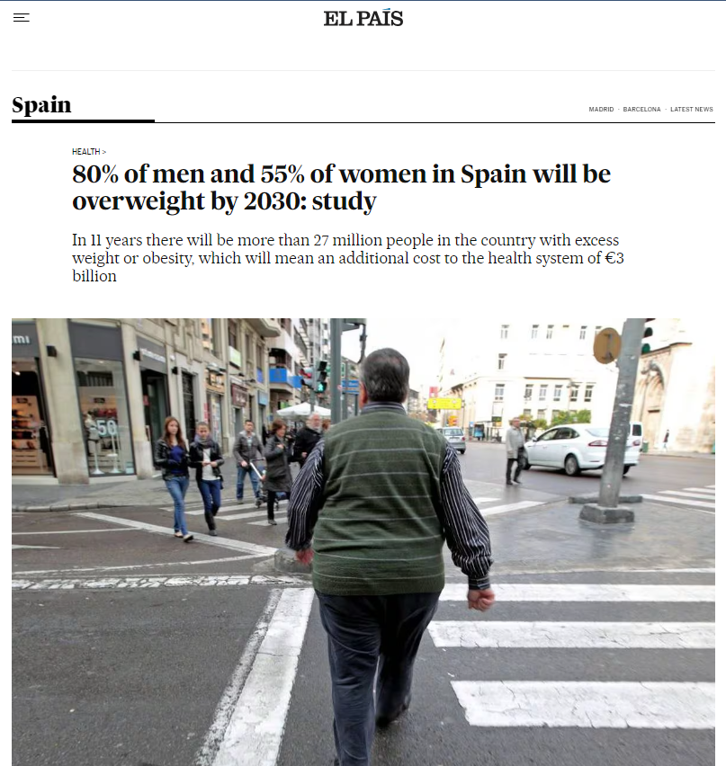

Slide 6

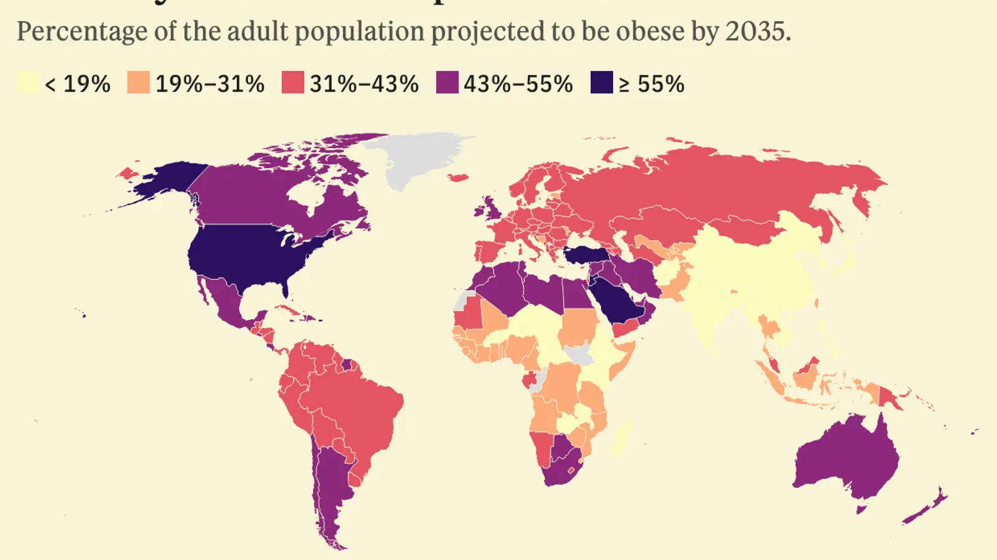

Slide 7
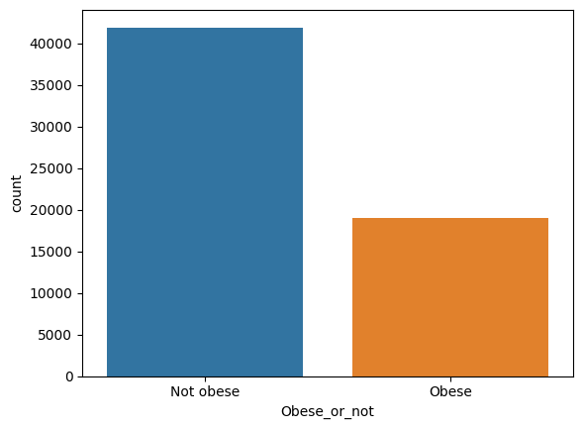
dataset
Categorical variables with records of (60920, 16)
Unbalanced:
Not obese: 41906
Obesese: 19014

Slide 8

Categorical Variables
Province
Sex
Marital status
Age
Working (past 12 months)
Education level
Perceived life stress
Smoker
Drinker (past 12 months)
Physical activity
Has a regular healthcare provider
Immigrant
Cultural or racial background
Food security
Personal income

Slide 9
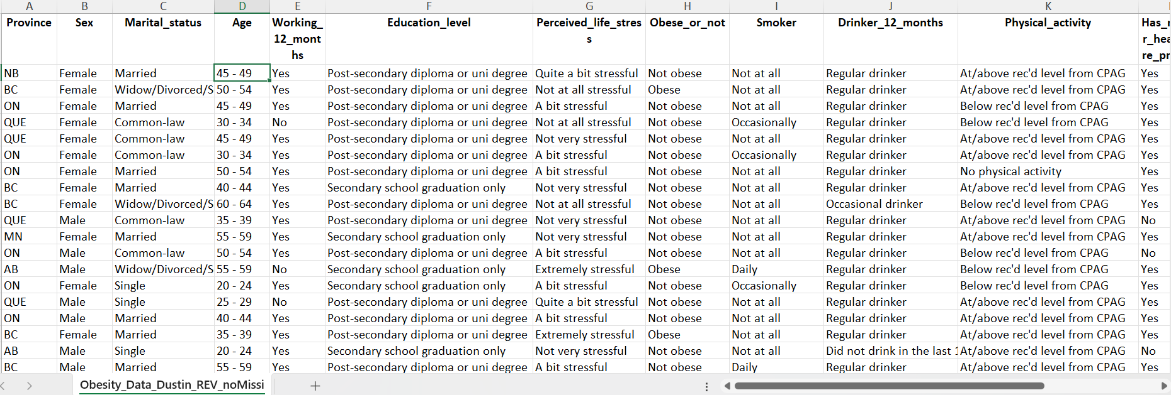

Slide 10
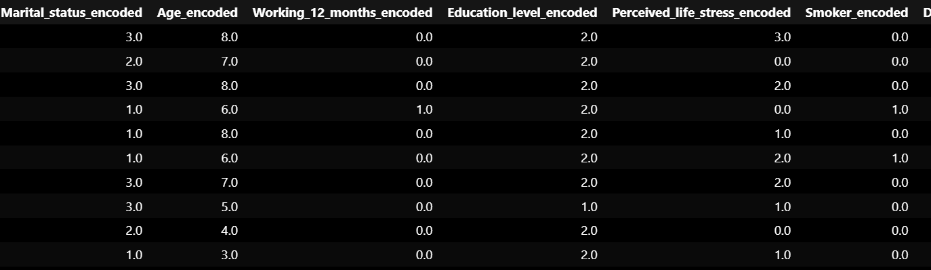

Slide 11
Machine Learning Models Used
Logistic Regression
Decision Trees
Random Forest
XGBoost
SVM

Slide 12
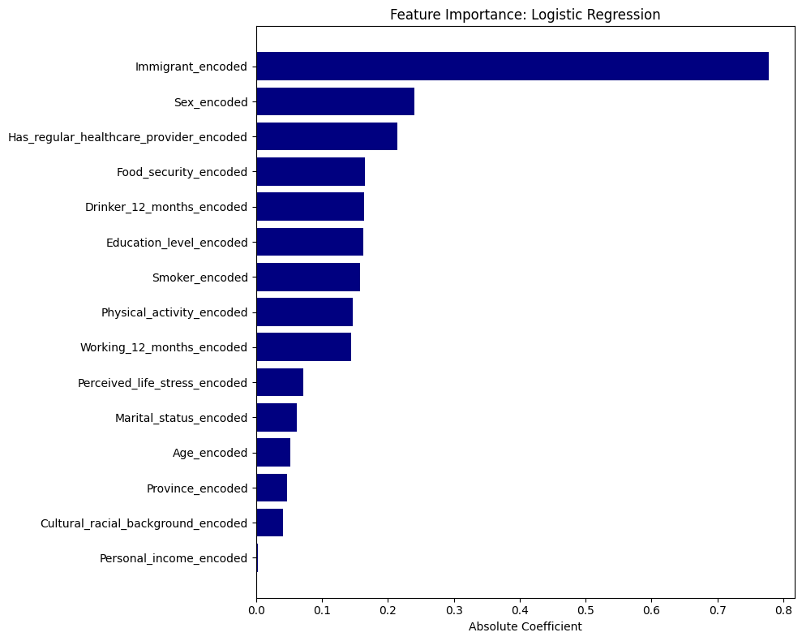

Slide 13
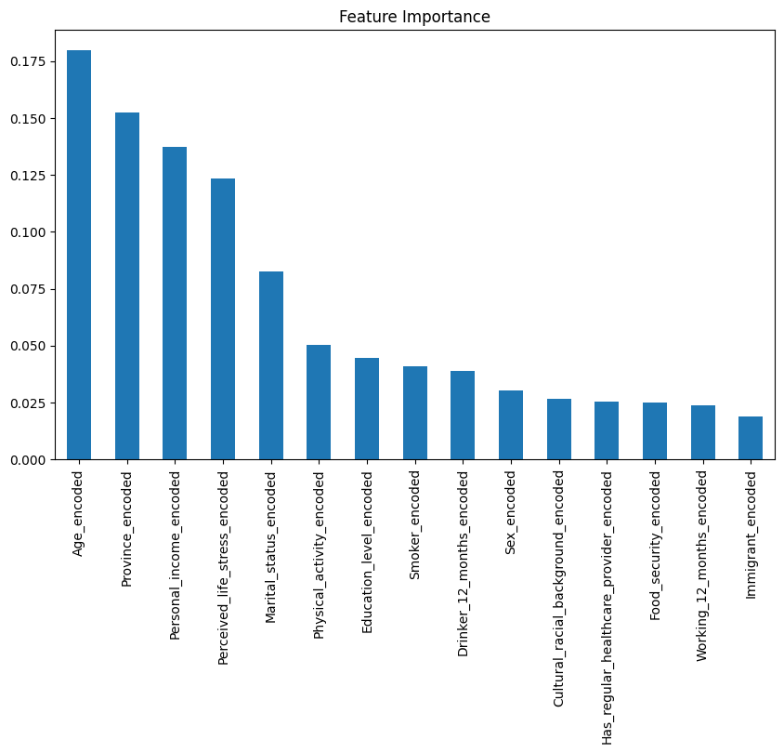
Feature Importance: random forest

Slide 14
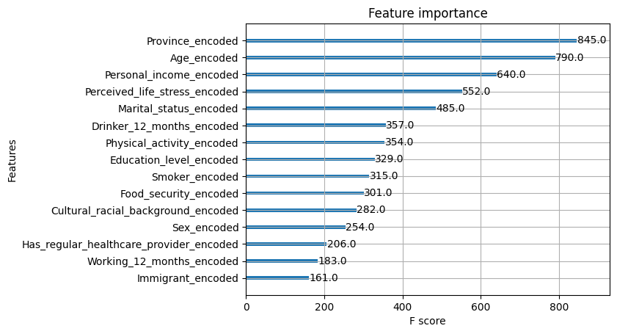
Feature importance: xgboost

Slide 15
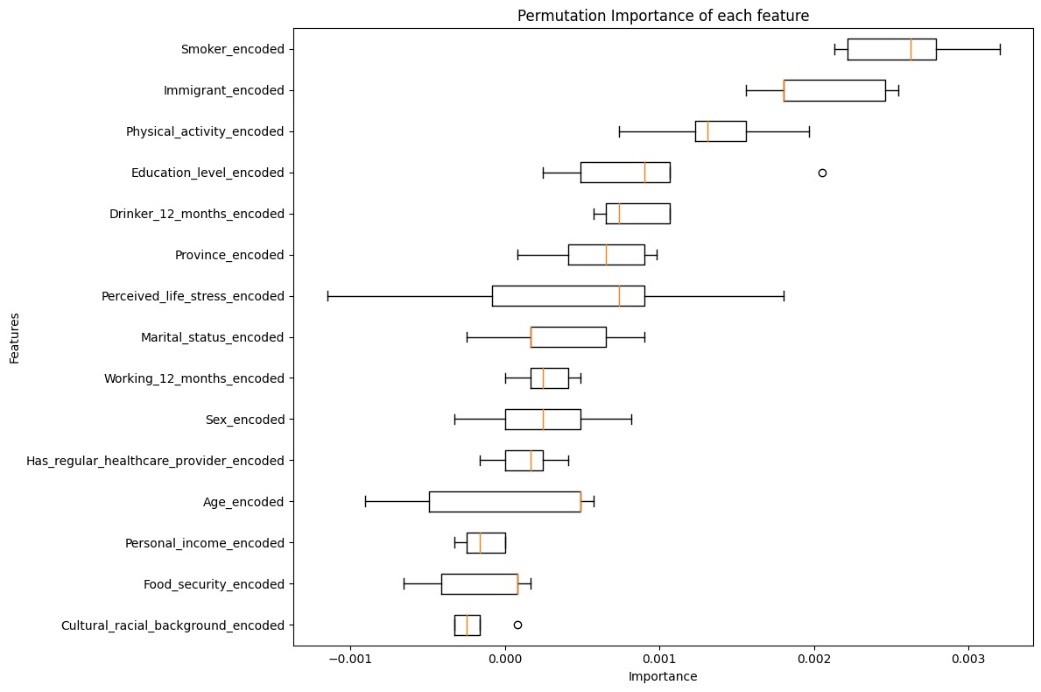

Slide 16
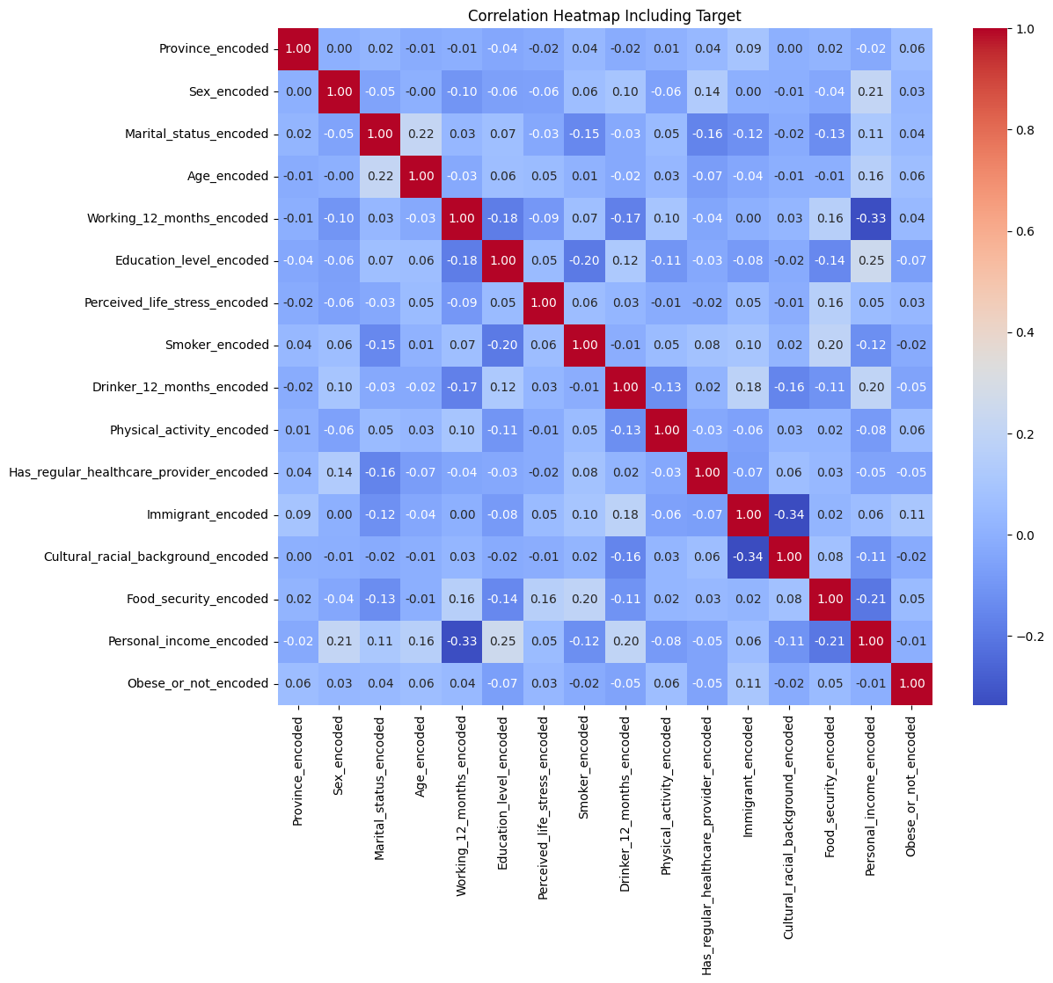

Slide 17
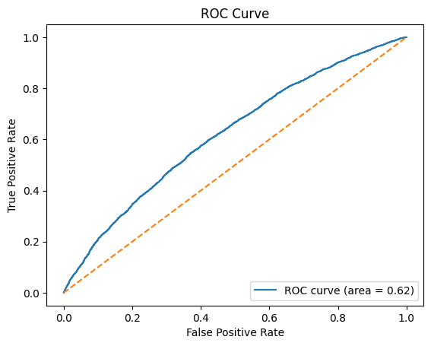
Logistic regression: 1st attempt default
Accuracy: 58%
F1 score: 8%

Slide 18
Logistic regression: final attempt ‘weighted’
Accuracy: 61%
F1 score: 45%

Slide 19
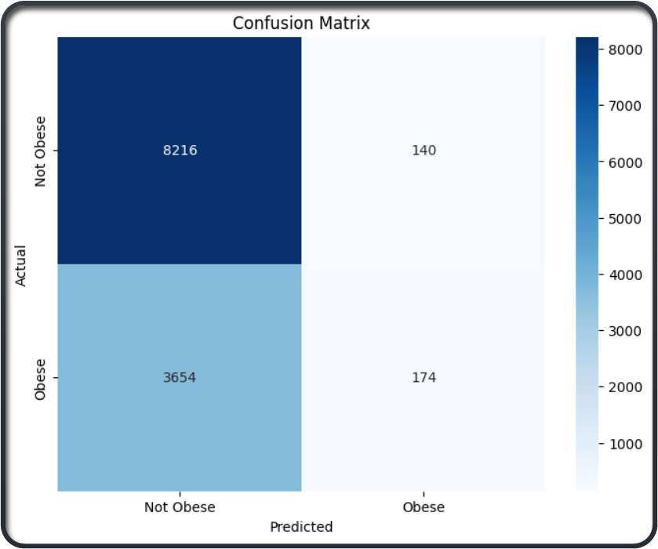
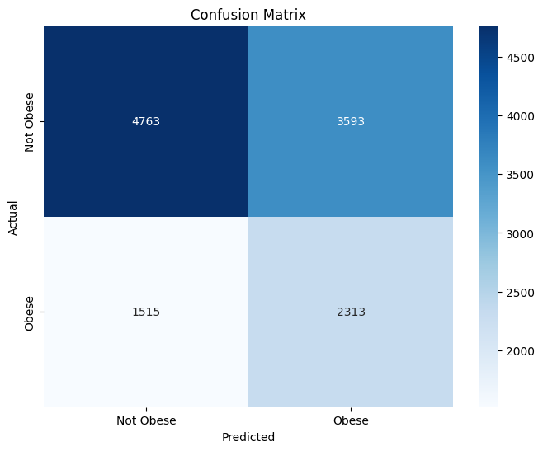
Logisitc Regression: first attempt vs balanced

Slide 20
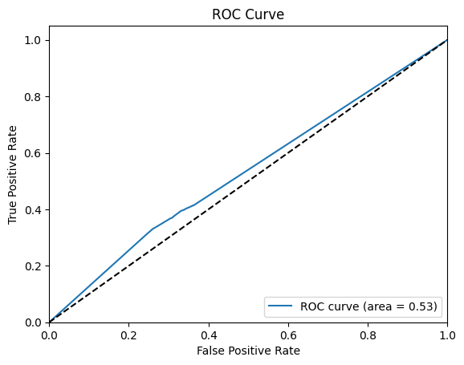
Decision trees model: 1st attempt
Accuracy: 58%
F1 score: 36%

Slide 21
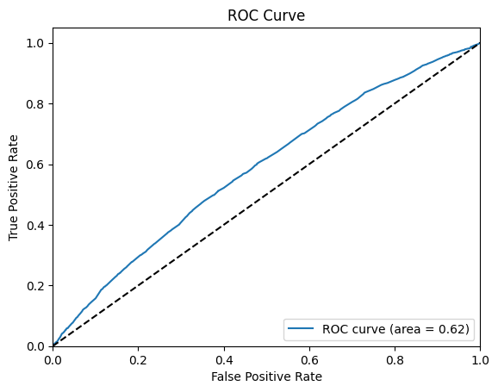
Decision trees model: parameter grid
Accuracy: 68%
F1 score: 19%

Slide 22
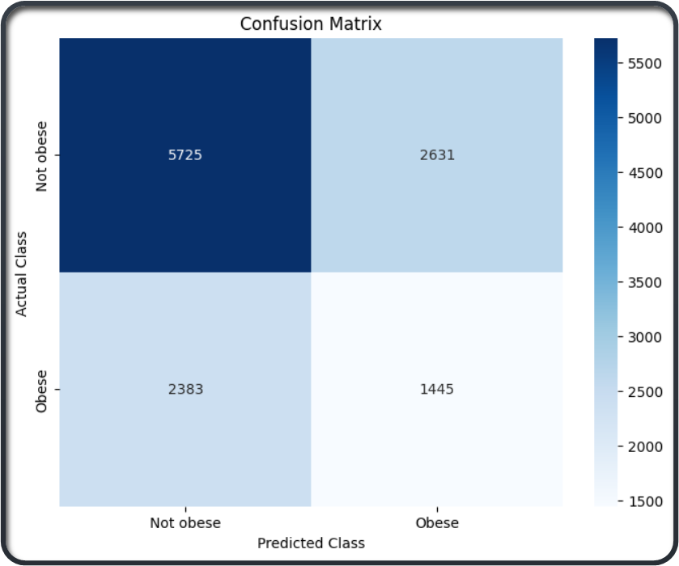
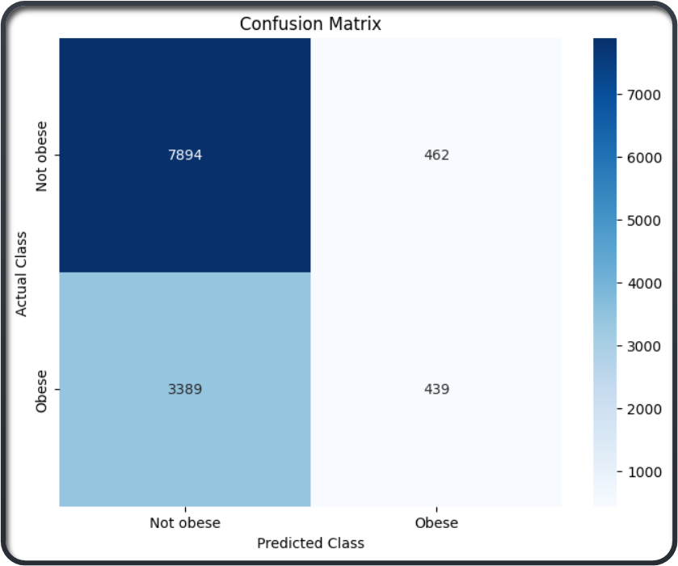
Decision trees 1st attempt vs parameter grid

Slide 23
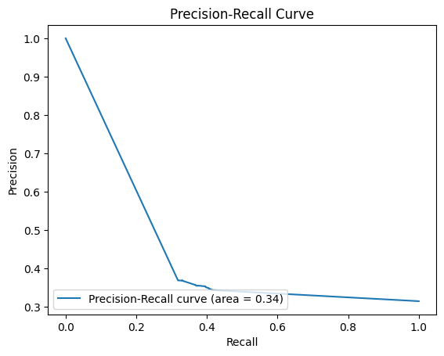
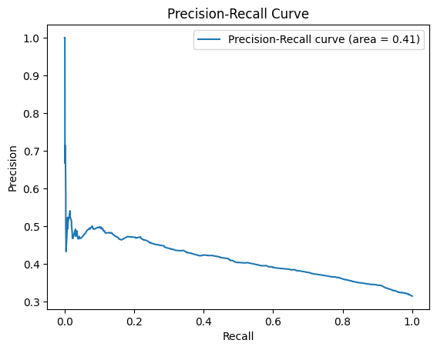
Decision Tree 1st Attempt vs Parameter Grid

Slide 24
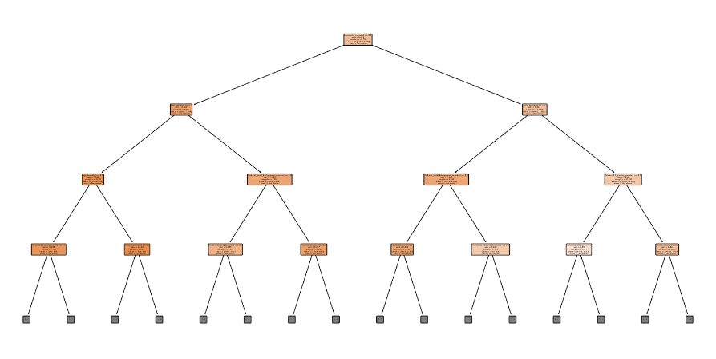
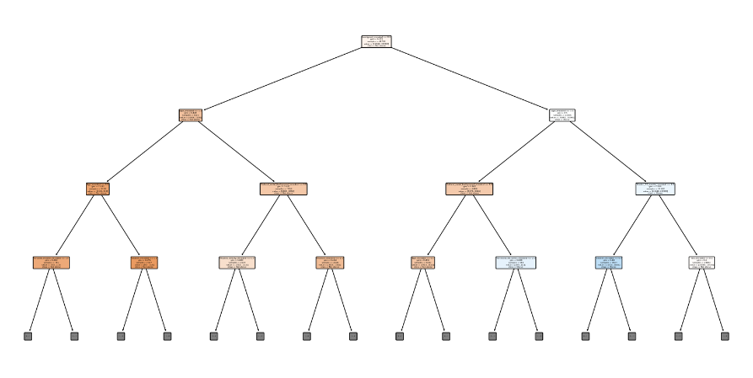

Slide 25
Decision trees: recursive elimination
All metrics got worse
Accuracy and F1 decreased along with the ROC-AUC score.

Slide 26
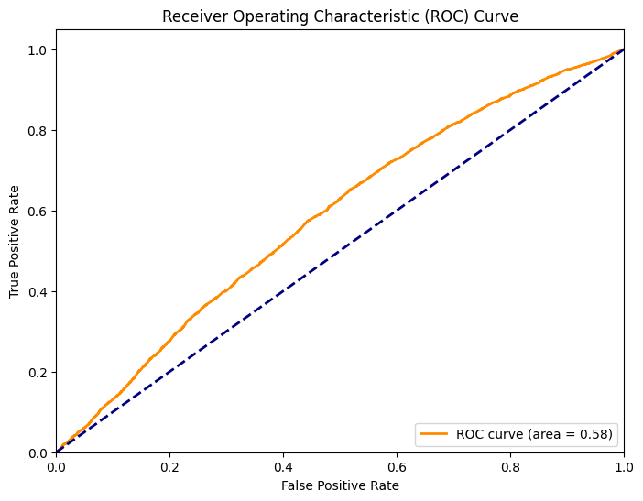
Random forest model: 1st attempt
Accuracy: 64%
F1 score: 29%

Slide 27
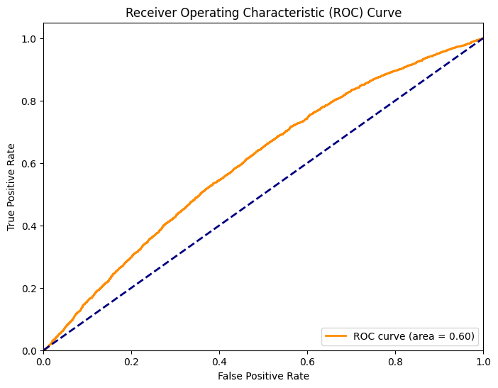
Random forest model: SMOTE TO BALANCE CLASSES
Accuracy: 63%
F1 score (weighted average): 62%

Slide 28
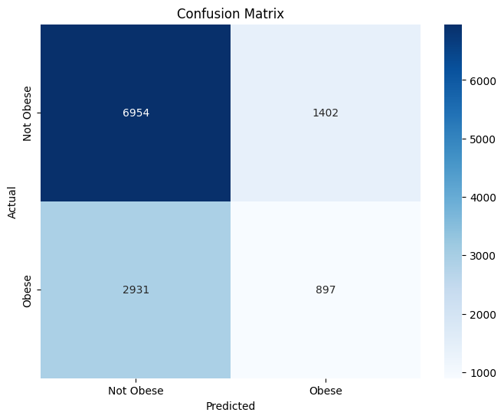
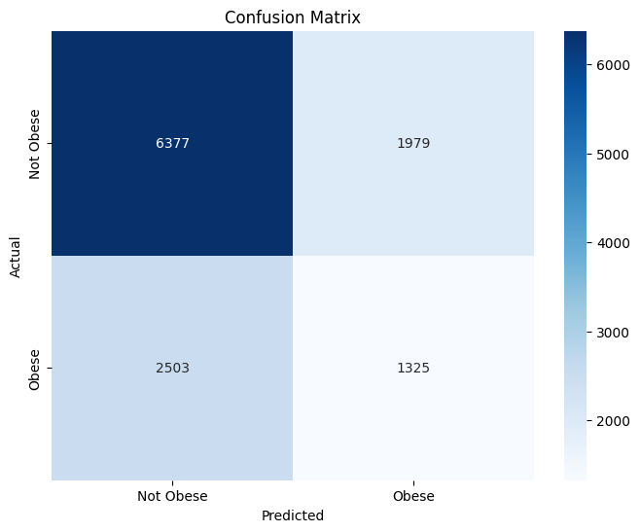
Random forest: 1st attempt compared to smote

Slide 29
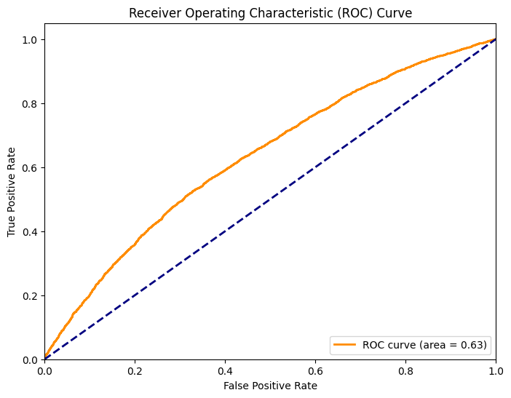
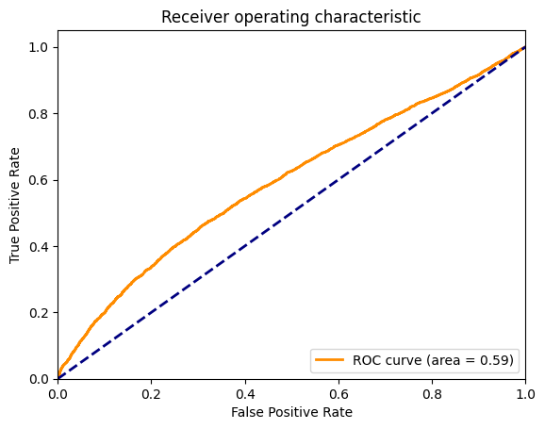
XGBOOST: 1st attempt vs hyperparameter tuning

Slide 30
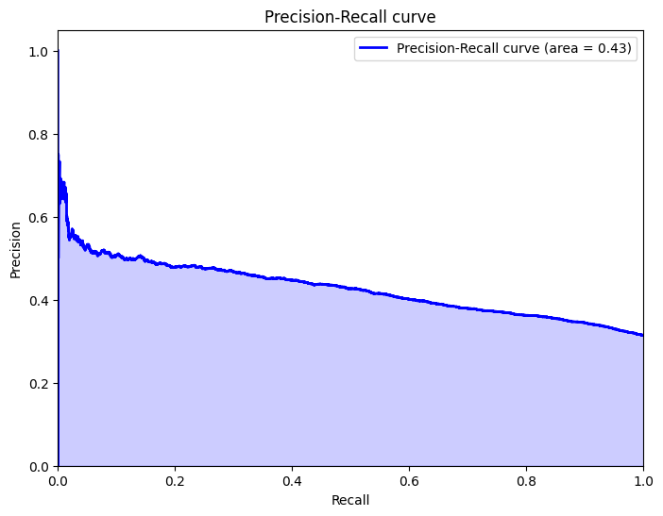
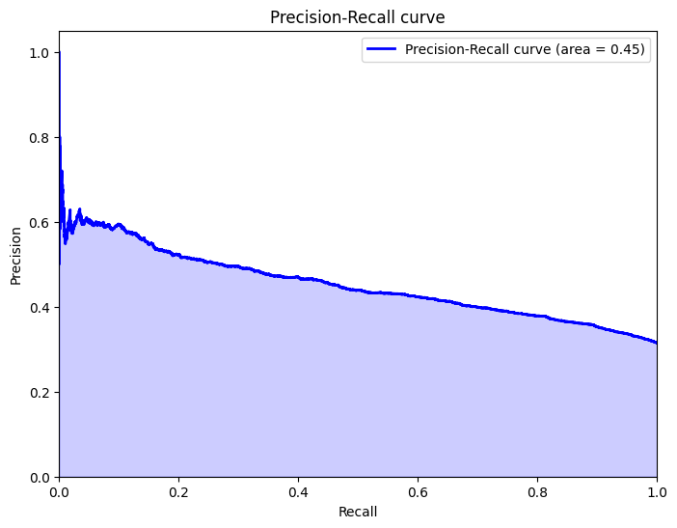
XGBOOST: 1st attempt vs hyperparameter tuning

Slide 31
XGBOOST: 1st attempt vs hyperparameter tuning
Metrics got only slightly better
Accuracy: 60%
F1: 62%
Accuracy: 65%
F1: 62%

Slide 32
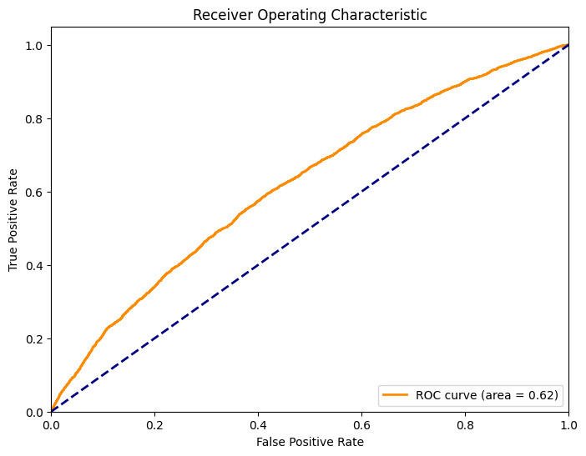
SVM: linear model vs RBF Kernel with RandomizedSearchCV
Accuracy: 68%
Accuracy: 69%

Slide 33
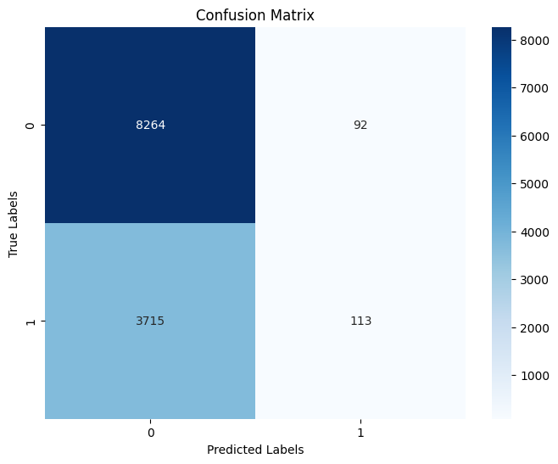
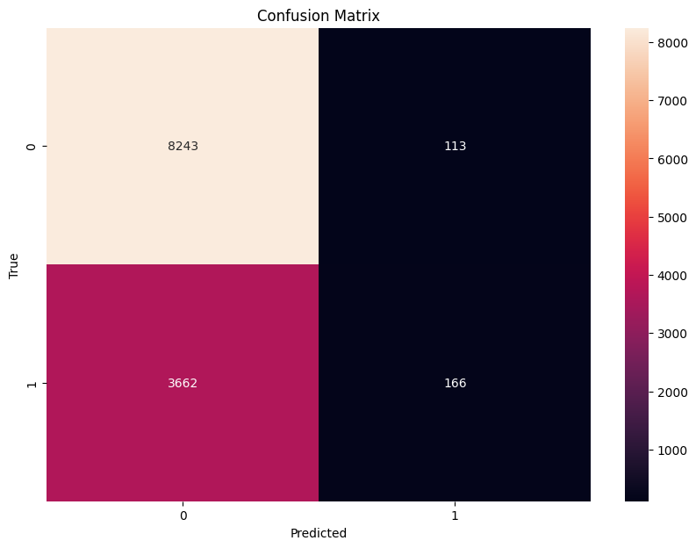
SVM: linear model vs RBF Kernel with Randomized Search CV

Slide 34
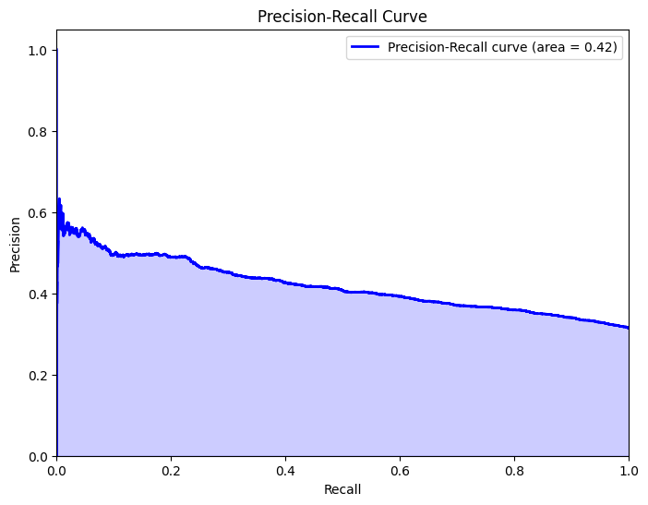
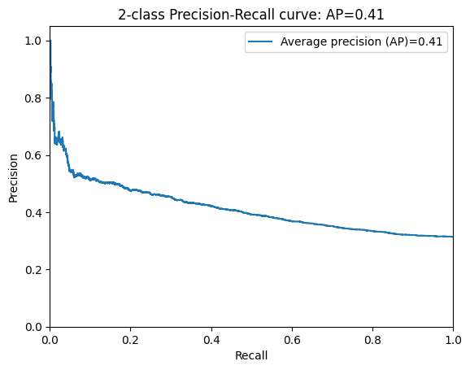
SVM: linear model vs RBF Kernel with RandomizedSearchCV

Slide 35
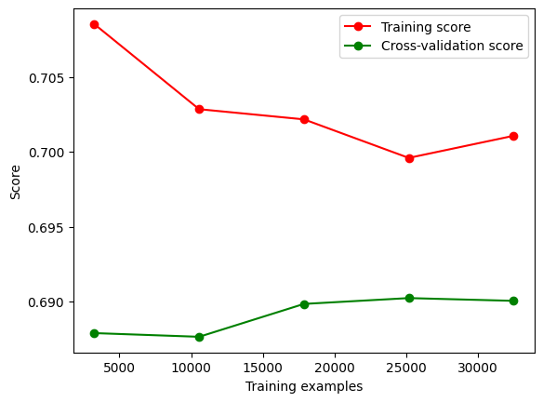

Slide 36
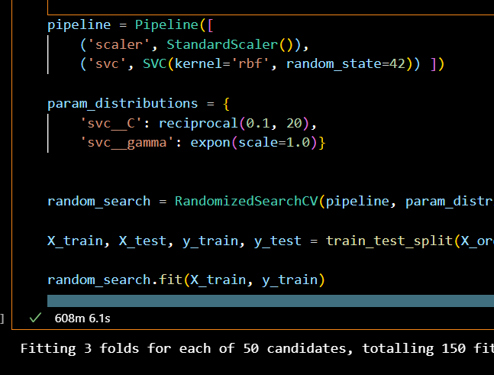
Took awhile…

Slide 37
Which model worked best in the end?
Best Accuracy: SVM: RBF Kernel with RandomizedSearchCV
Best F1 score: XGBOOST with Hyperparemeter tuning
Best ROC-AUC: XGBoost 1st attempt
Best Precision-Recall: XGBoost 1st attempt

Slide 38
Recall is arguably the best metric in this case
Why?
Recall is the best because the cost of false positives is low.
If someone is overweight and is falsely classified as ‘obese’, the worst thing to happen is that their doctor would tell them to take their weight more seriously.
This differs from other health-related models where the the cost of a false positive could potentially lead to unnecessary, treatments like medication or surgery.

